Slide 1

G2M CASE STUDY
VIRTUAL INTERNSHIP
NAME:MAUREEN WANJIKU
LOCATION:KENYA
TEAM:DATA AND ANALYTICS
DATE:14-March-2021

Slide 2

Background of the study
XYZ is a private firm in US. Due to remarkable growth in the Cab industry in the last few years and multiple key players in the market ,it is planning for an investment in the industry.
Objective: Provide actionable insights to help the firm identify the right company to make their investment.

Slide 3
Data Exploration
Time period:1/01/2016 to 12/31/2018
19 features
Total data points
Assumptions
Profit is calculated using Price Charged and Cost of Trip keeping other factors constant
Outliers are present in Price Charged but there wasn’t enough evidence to invalidate them example no trip duration data.
Count of Transaction ID is the number of users.
Cab_Data.csv
Transaction_ID.csv
Customer_ID.csv
City.csv
Final cab data

Slide 4
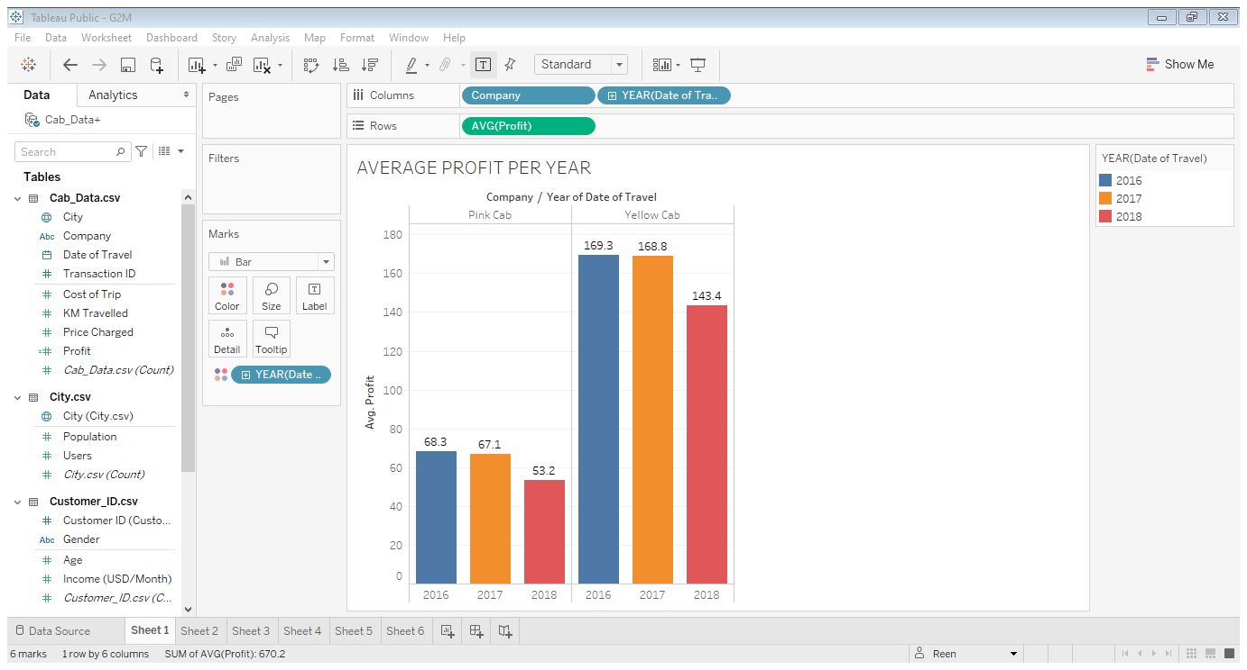
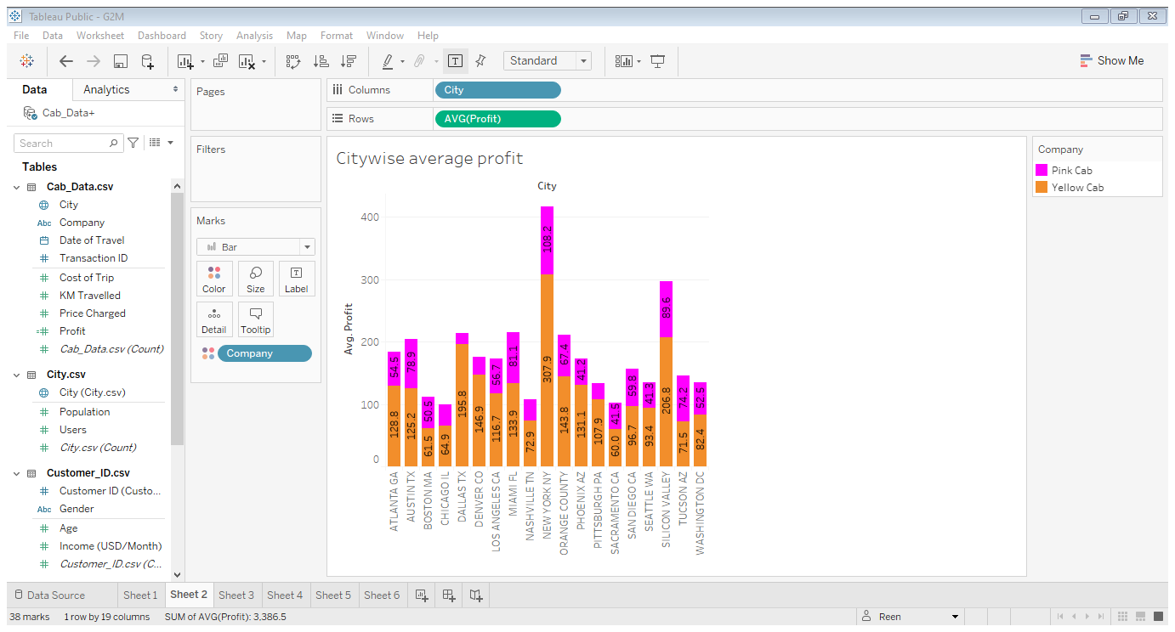
Profit Analysis
Yellow Cab has a higher average profit in all the years that Pink Cab

Slide 5
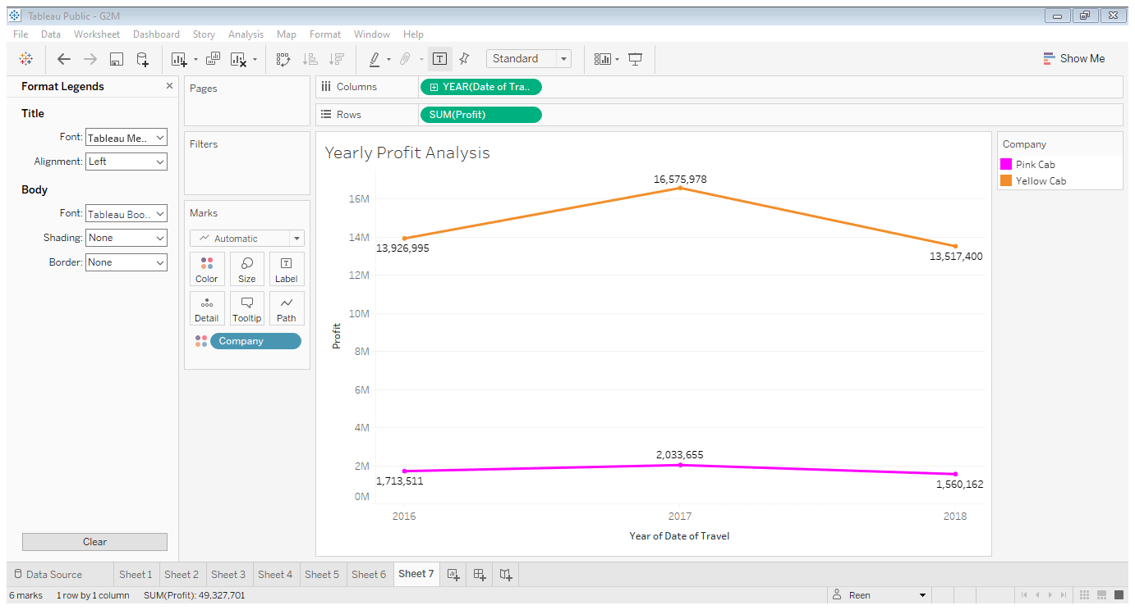
Profit Analysis
Both companies had a rise in profits 2016 to 2018 with Yellow cab having more.
2017 to 2018 the companies faced a decline in profits Pink Cab having a significant loss.

Slide 6
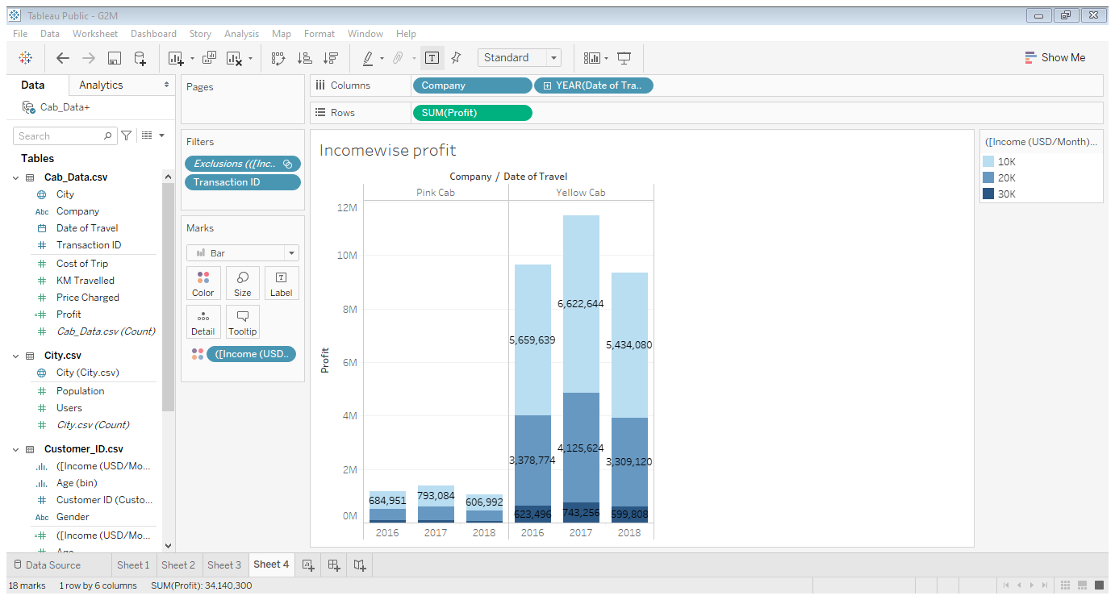
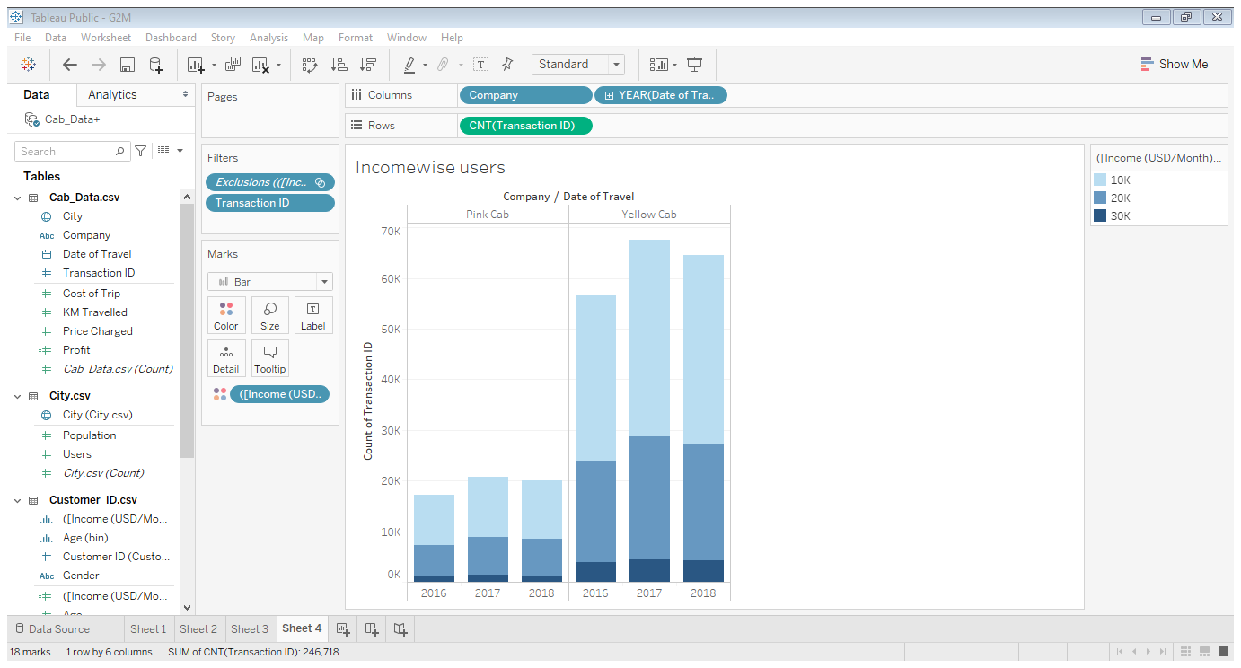
IncomeWise profit and Customer base Analysis
Majority of the users are low and middle income users

Slide 7
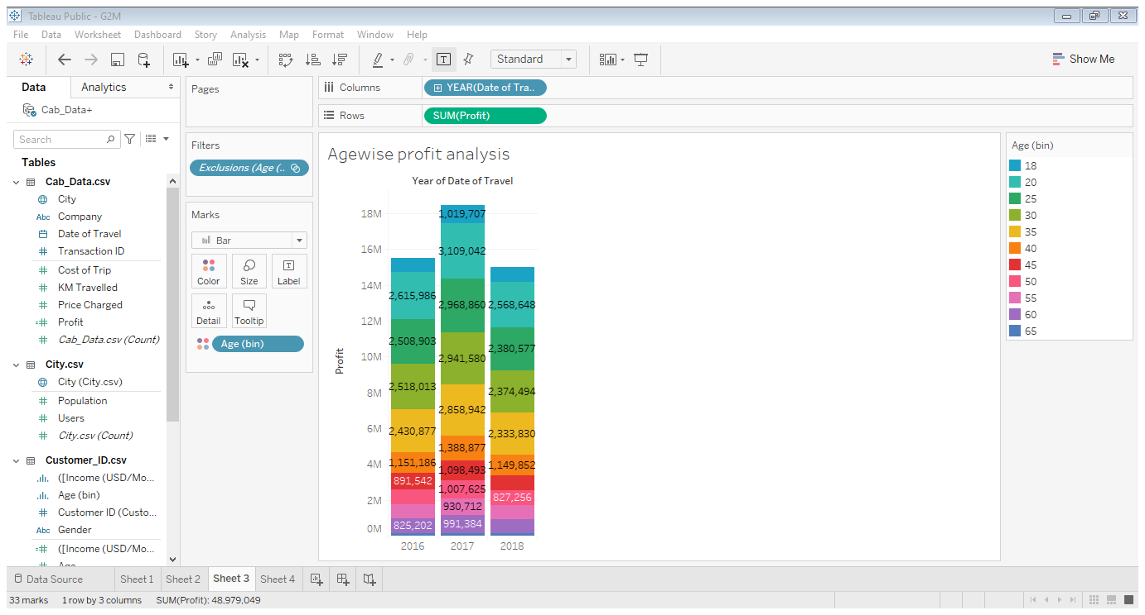
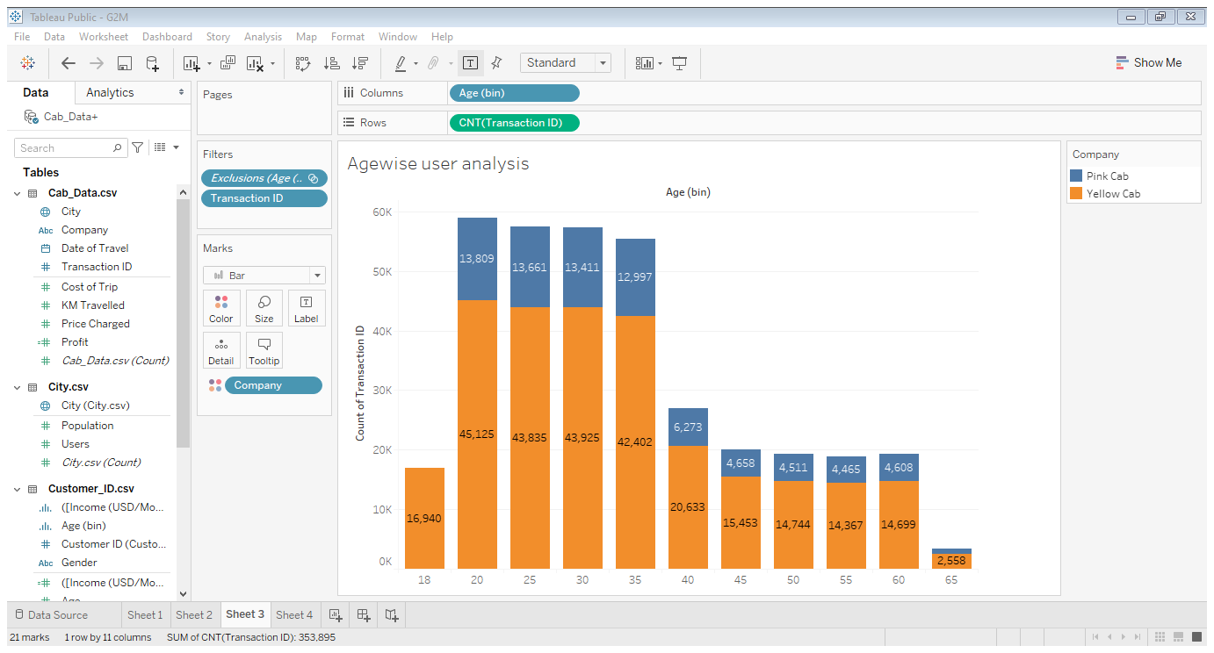
Age Wise Profit and Customer base Analysis
Majority of users are in the ages 18 to 35

Slide 8
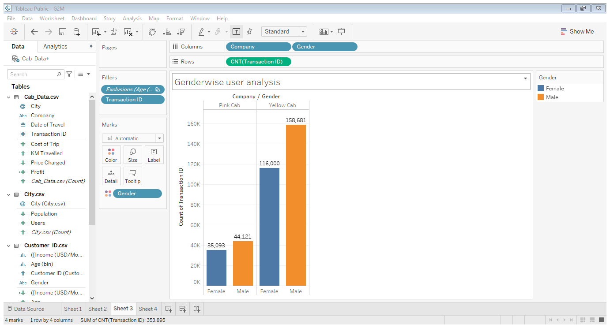
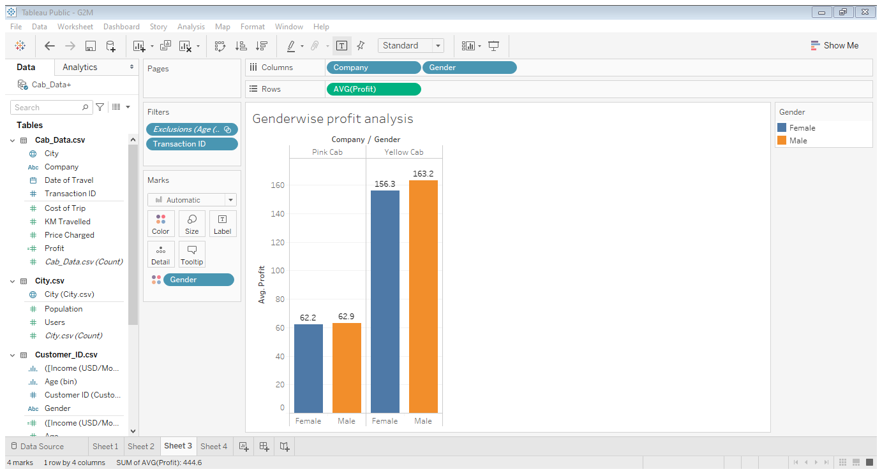
Gender Wise Profit and Customer base Analysis
User gender distribution is almost equal in both companies

Slide 9
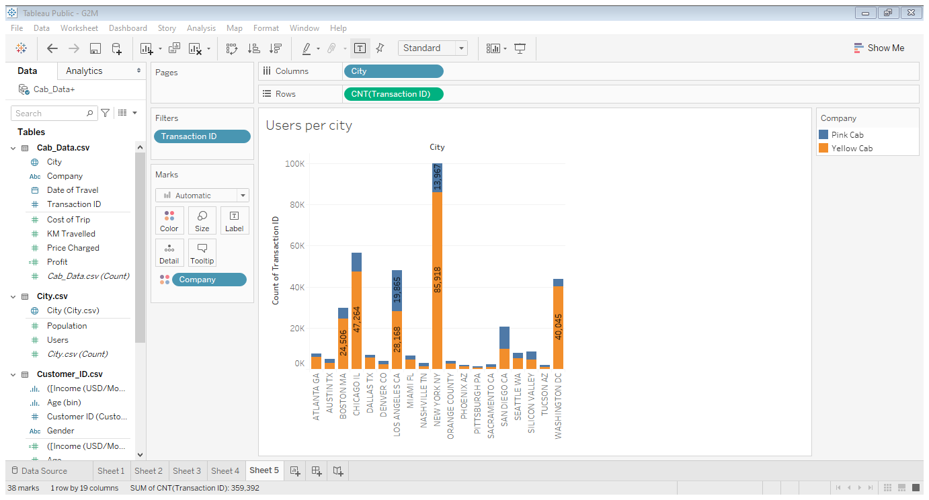
Gender Wise Profit and Customer base Analysis
Yellow Cab has a higher number of uses in all of the cities

Slide 10
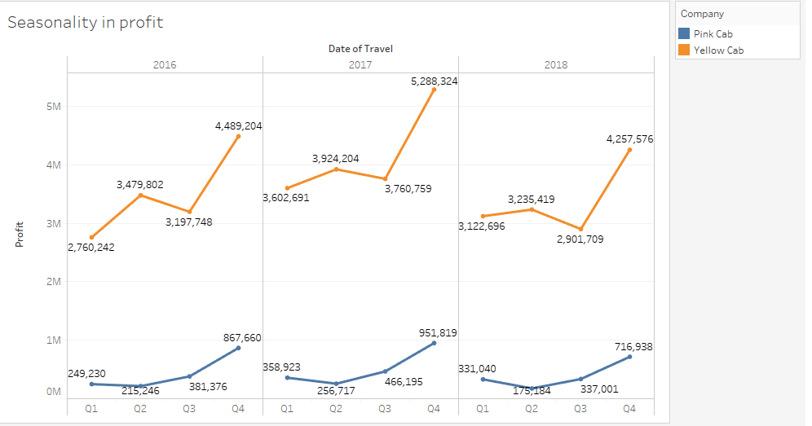
Profit Analysis
Seasonality component quarterly .

Slide 11
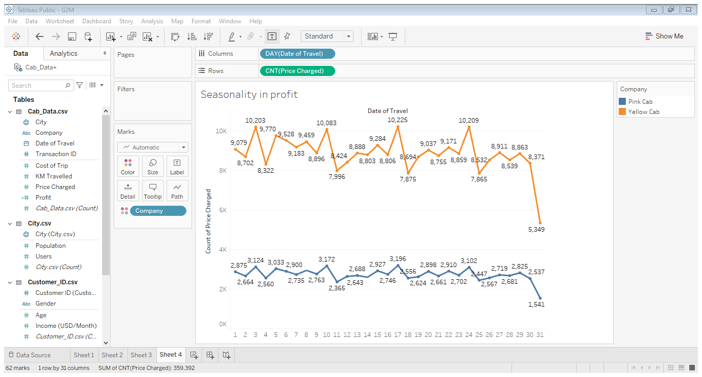
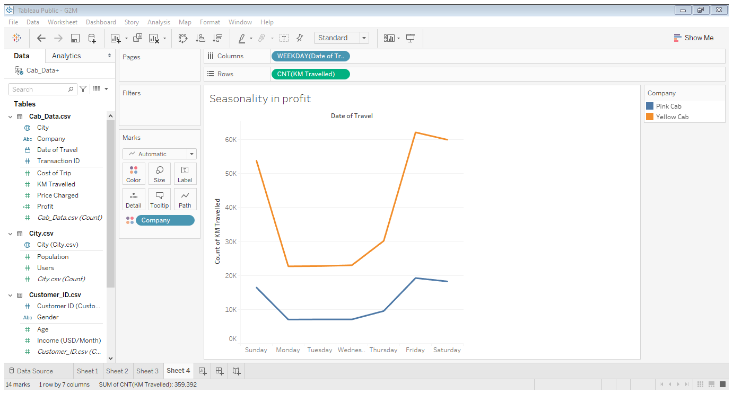
Monthly and weekly Seasonality
There is a pattern where the 3rd day of the month the number of cab users increase and pattern is repeated after 7 days .
More users on the first day of week then a decline during the week followed by a spike at the end of the week-Friday and the pattern continues

Slide 12
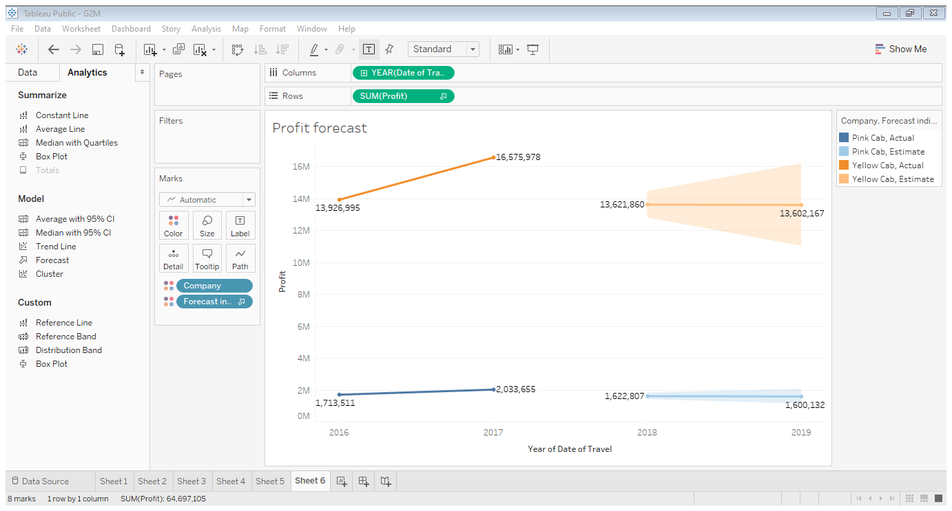
Profit forecast

Slide 13
Recommendation
Following the evaluation of the two cab companies Yellow Cab is the better Company to Invest.
Profit :Yellow Cab has made more profit than Pink Cab in the evaluated time period.
Customer /Users: Yellow Cab has a higher customer/user base than Pink cab. Following that it has a higher count of users.
Age wise : Yellow cab has users in all age groups ,it is more popular in the ages 18-35.It is even popular with the 65+ age groups
Gender wise: Both cabs are popular with both genders .Yellow Cab has more male users than female.
Income wise : Both Cabs are popular with the Low and Middle Income earners.
City wise: Yellow Cab has a higher customer reach in majority of the cities than Pink Cab
Following the profit forecast both companies will face a loss in 2019 .Pink Cab will face a more significant loss.
In conclusion I would recommend Yellow Cab as the better company to make an Investment.

Slide 14
Thank You

